Slide 1



Sales Project (Power BI)
View in Power BI
Last data refresh:
3/22/2023 7:45:05 AM UTC
Downloaded at:
3/22/2023 7:47:01 AM UTC

Slide 2
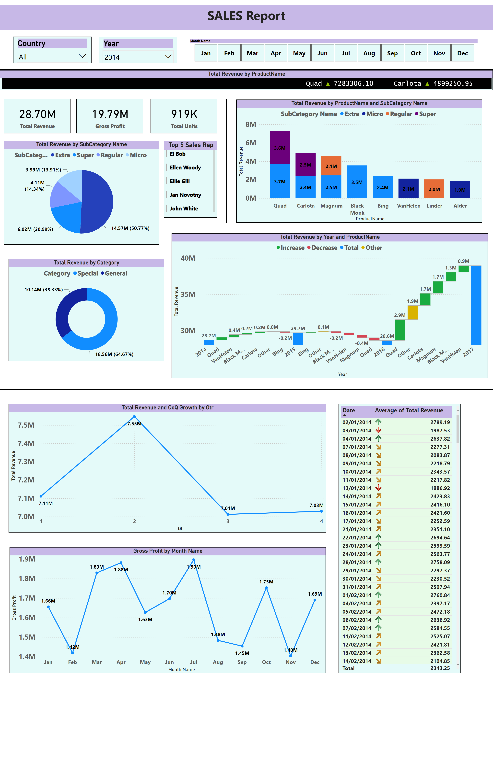
Page 1
Notes:
textbox
No alt text provided
slicer
No alt text provided
slicer
No alt text provided
shape
No alt text provided
shape
No alt text provided
card
No alt text provided
card
No alt text provided
card
No alt text provided
shape
No alt text provided
pieChart
No alt text provided
donutChart
No alt text provided
Top 5 Sales Rep
No alt text provided
ScrollingTextVisual1448795304508
No alt text provided
waterfallChart
No alt text provided
columnChart
No alt text provided
slicer
No alt text provided
shape
No alt text provided
lineChart
No alt text provided
lineChart
No alt text provided
tableEx
No alt text provided

Slide 3
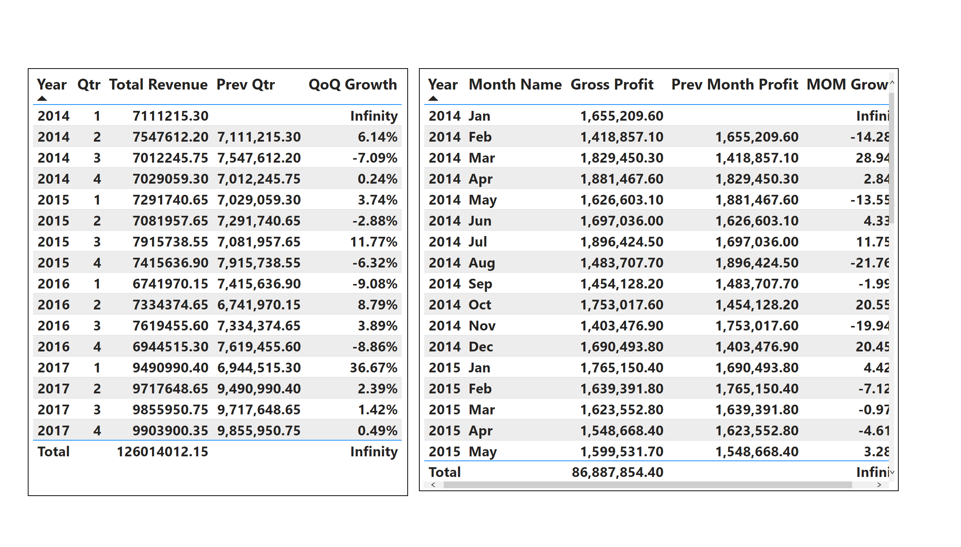
Page 2
Notes:
tableEx
No alt text provided
tableEx
No alt text provided

Slide 4
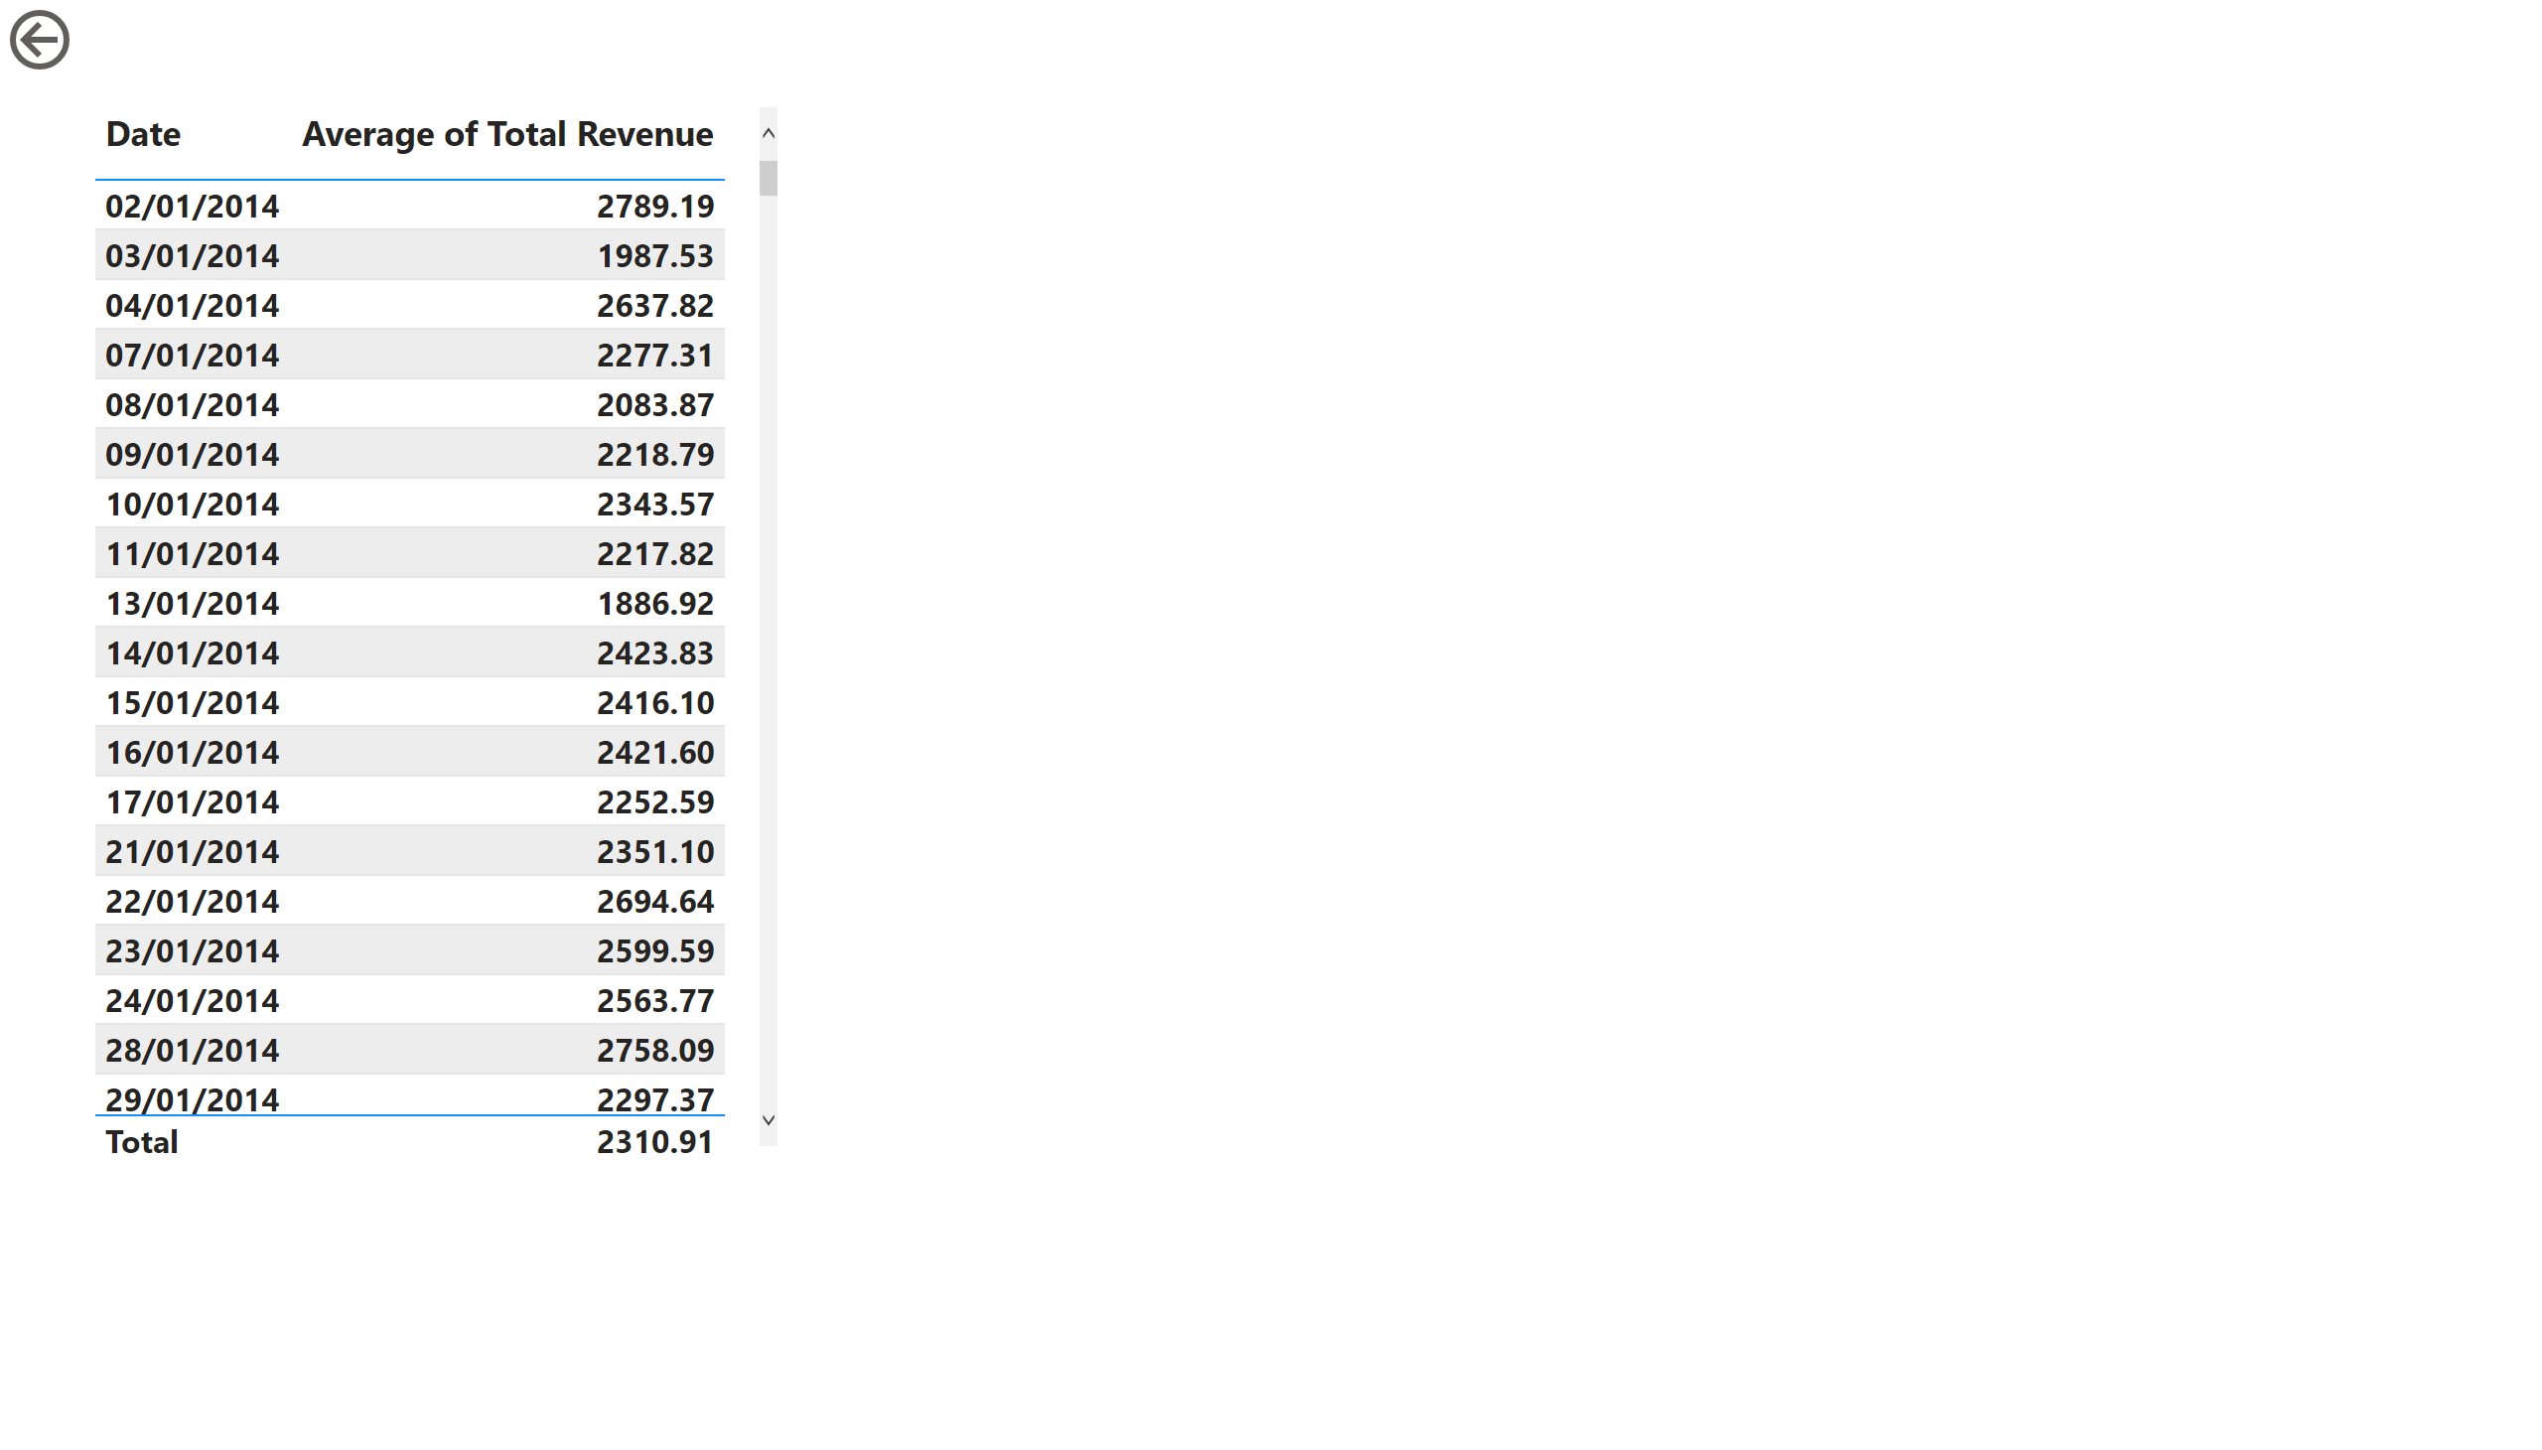
Page 3
Notes:
tableEx
No alt text provided
actionButton
No alt text provided

Slide 5
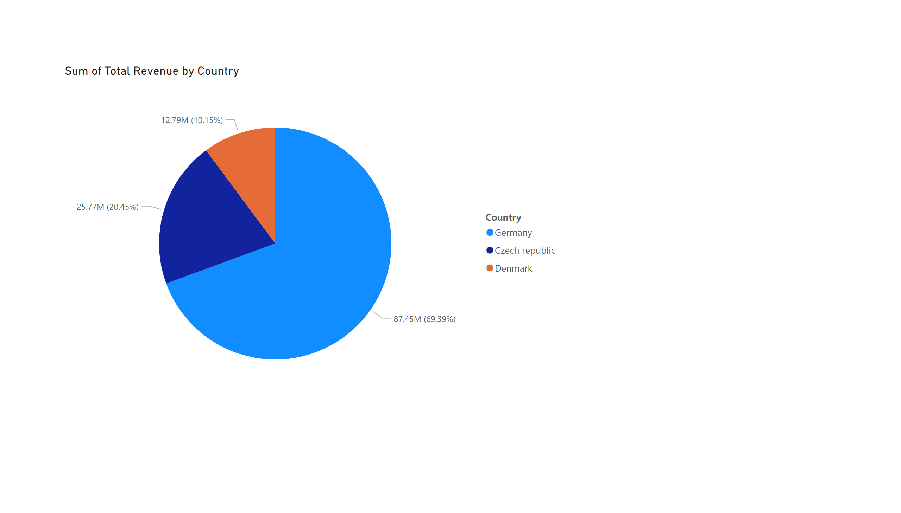
Page 4
Notes:
pieChart
No alt text provided

